Slide 1
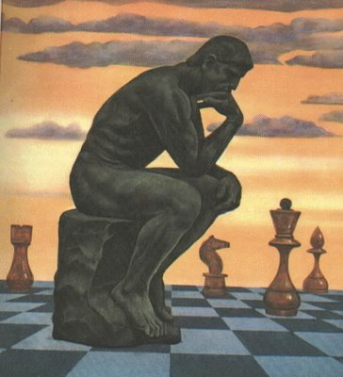
THE EDUCATIONAL POWER OF CHESS

Slide 2
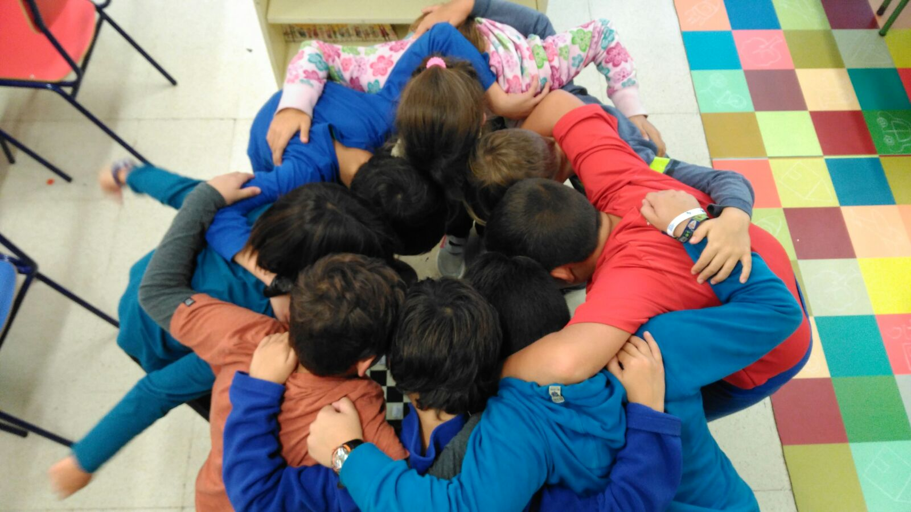
Remember-Remember

Slide 3
Spanish Journal of Psychology, 2012/2016. Aciego, García and Betancort
Universidad de La Laguna,
Tenerife, España.
170 chess players
60 football and basketball players
Boys and girls,
6 -16 years old
Conclusion: Educational Chess students get better results on both, cognitive AND EMOTIONAL INTELLIGENCE

Slide 4
A VERY EFFICIENT APPROACH
TRANSVERSAL: Emotional Intelligence
INTERDISCIPLINARY
-Maths
-Language/Reading
-History
-English (Foreign Language)
-…

Slide 5
VERY STRONG CONNECTION:
SCHOLASTIC-COMPETITION
100% STUDENTS: BASIC KNOWLEDGE
DRAMATIC INCREASE:
-EXTRA-CURRICULAR CHESS CLASSES
-CLUB MEMBERS
-FEDERATION REGISTERED PLAYERS
-EASIER SPONSORHIP AND SUPPORT
-…

Slide 6
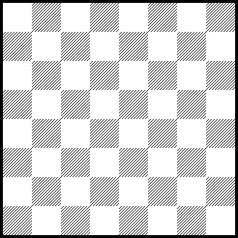

Is the chess board simmetrical?
Depending on the axis
Vertical axis:
NO
Horizontal axis: NO
Different color corners

Slide 7
DIAGONAL AXIS: YES!
8
7
6
5
4
3
2
1
a b c d e f g h

Slide 8
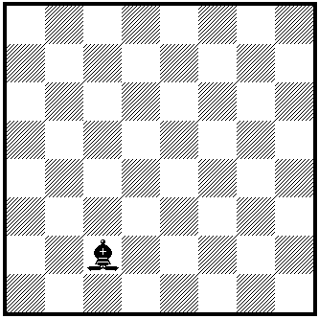
STUDENTS ACCEPT THIS IS ALSO A RECTANGLE
8
7
6
5
4
3
2
1
Although it is inclinated!
a b c d e f g h

Slide 9
8
7
6
5
4
3
2
1
a b c d e f g h

Slide 10
8
7
6
5
4
3
2
1
a b c d e f g h

Slide 11
¿How many squares are on the chess board?
The first answer is 64
But, is the whole board a square?
… then we get 65
But there are many more…
2x2, 3x3, 4x4, 5x5, 6x6, 7x7
…
…indeed many more! TOTAL: 204

Slide 12
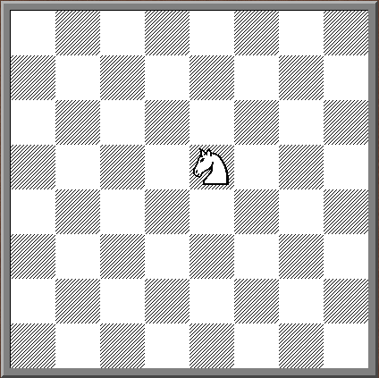
Circunferences on a square??
8
7
6
5
4
3
2
1

Slide 13
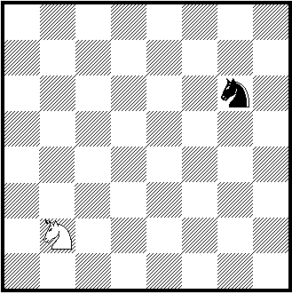
Three dimensions geometry??
8
7
6
5
4
3
2
1
a b c d e f g h

Slide 14
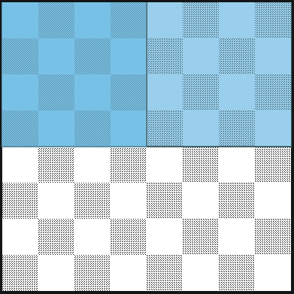
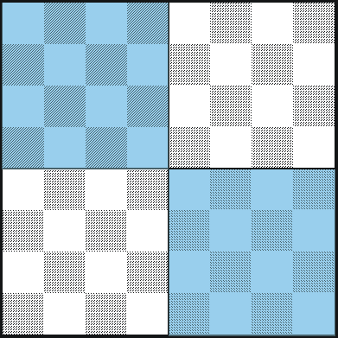
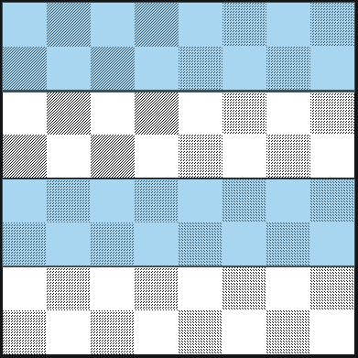
Continuous
Discontinuous
8
7
6
5
4
3
2
1
8
7
6
5
4
3
2
1
8
7
6
5
4
3
2
1
a b c d e f g h
a b c d e f g h
a b c d e f g h
Aritmética emergente
1/2
1/4 + 1/4 = 2/4
1/4 = (4x4)/64 = (2x8)/64 = 16/64
2/4 = 32/64 = 1/2
= 1/4
2

Slide 15
Problems with different quarters
1/4
1/8
1/4
1/8
1/4
1/4
1/8
1/4
1/4
1/8

Slide 16
Chess and Arithmetic
R + Q + N =18
Q + 3P = 13
Q – R = 5
N + ? = 6
R = 5P
R = N + 2P
R = B + 2P
R = Q – R

Slide 17
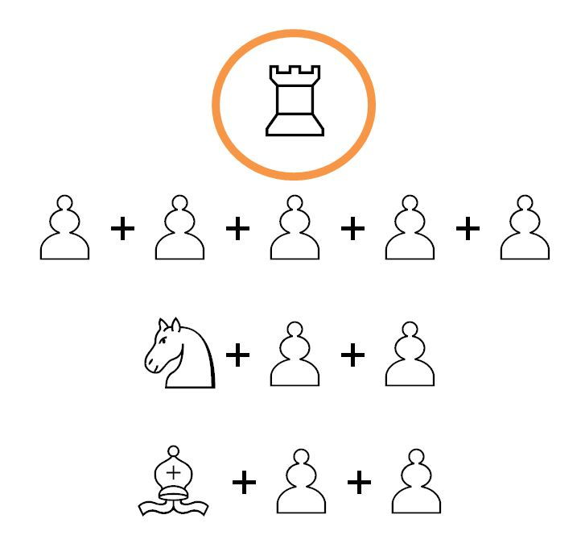
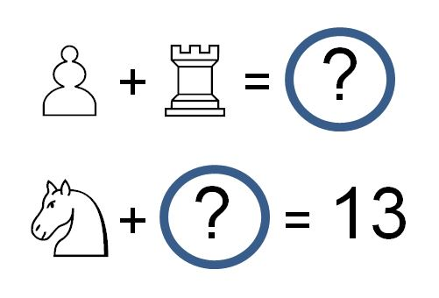
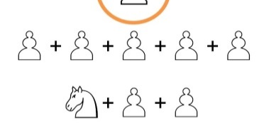

Slide 18
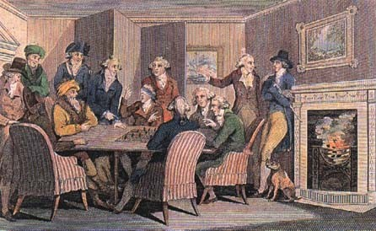
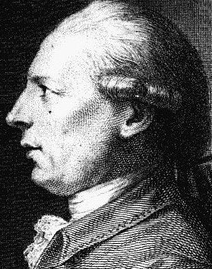

THE REVOLUTIONARY PAWNS
Philidor, 1726 – 1795

Slide 19

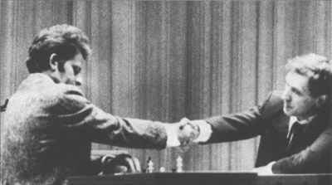

Cold War,
Hot Board.
Match Fischer – Spassky, 1972, Iceland

Slide 20
120 YEARS OF WORLDWIDE RESEARCH
EDUCATIONAL CHESS STUDENTS
Develop greater intelligence (including emotional)
Better academic performance
VERY SIGNIFICANT IMPROVEMENTS
Mathematics (Trier, Aarhus, Barcelona)
Reading (Margulies, Barcelona)

Slide 21
PRESCHOOL IS CRUCIAL
“LEARNING BY PLAYING AND PLAYING BY LEARNING”
KINDERGARTEN (0-5YEARS OLD) IN URUGUAY, COLOMBIA, SPAIN AND OTHER COUNTRIES
CHESS FOR TEACHING VALUES

Slide 22

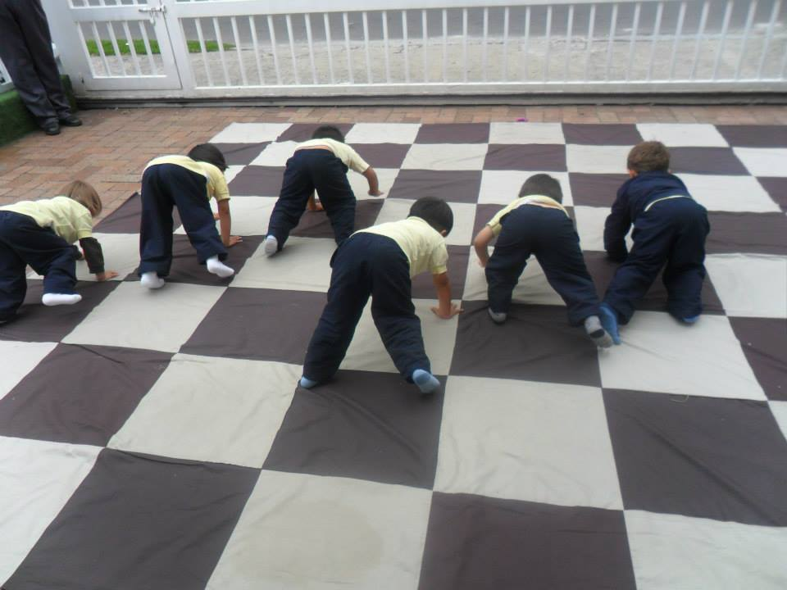
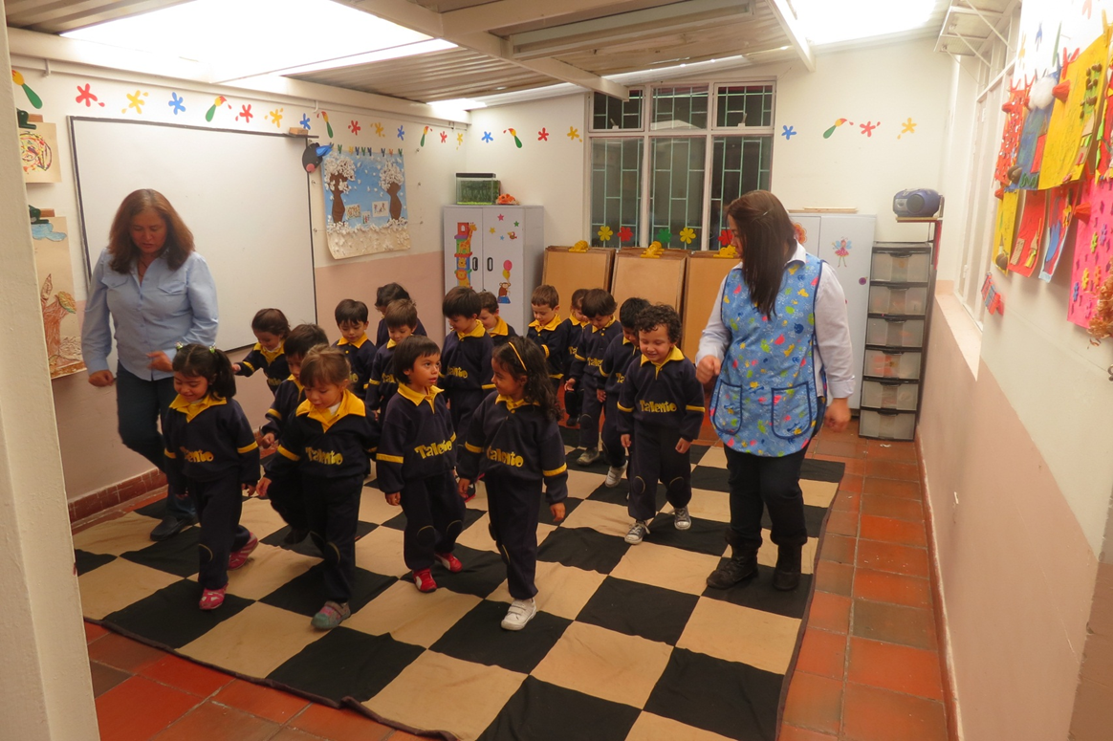

Slide 23



Slide 24
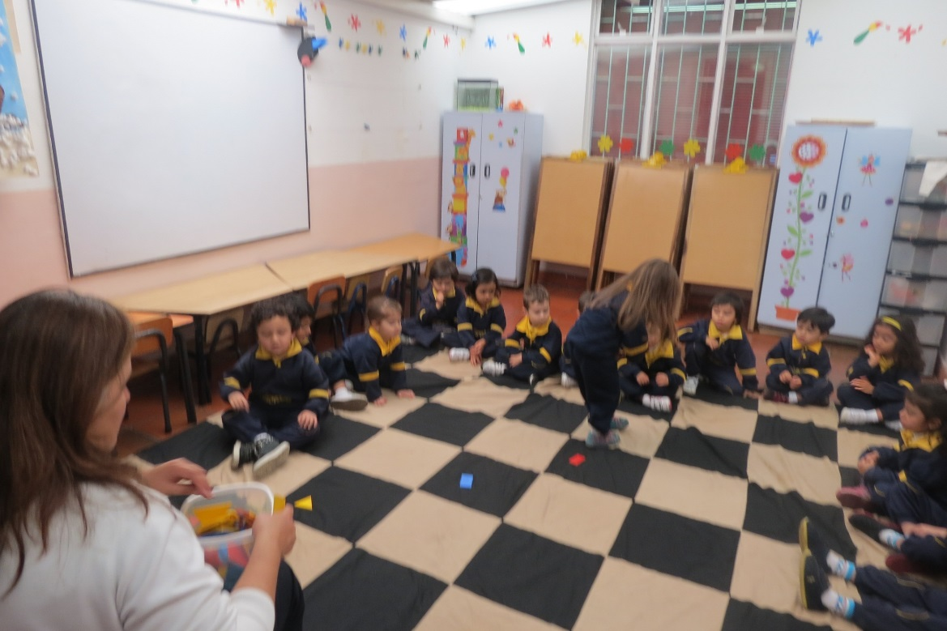

Slide 25
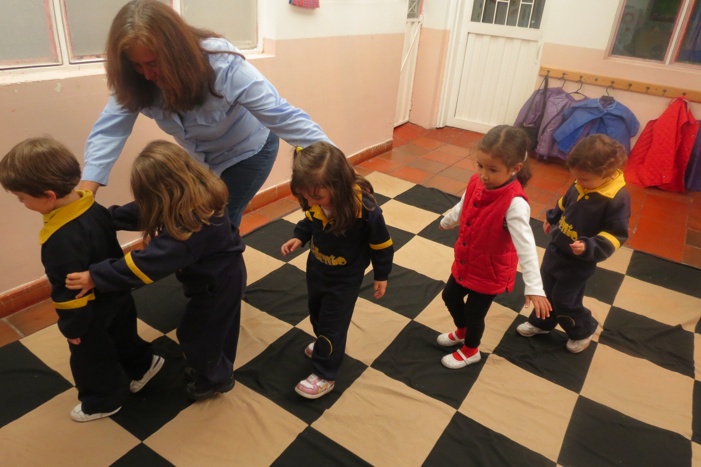

Slide 26
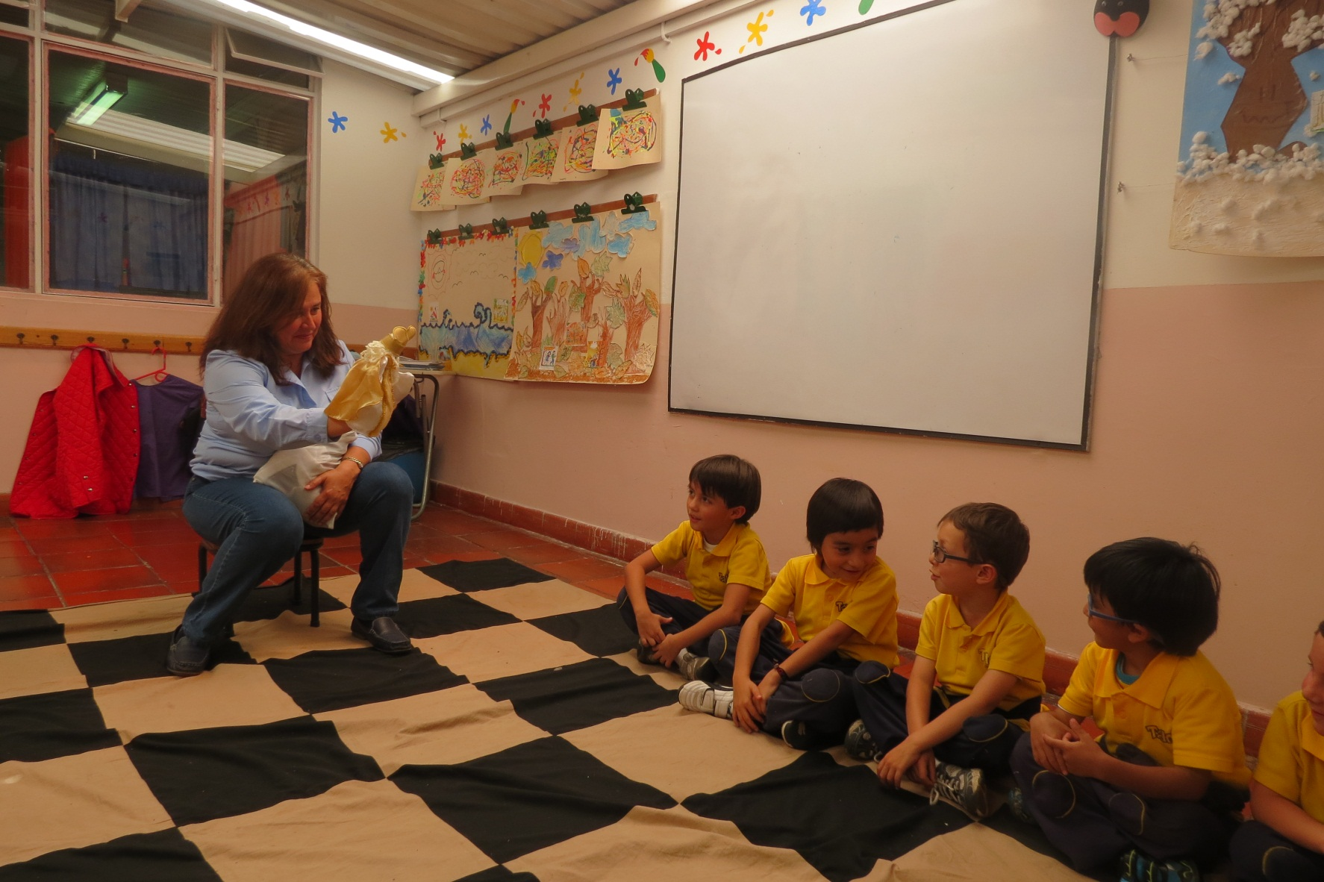

Slide 27
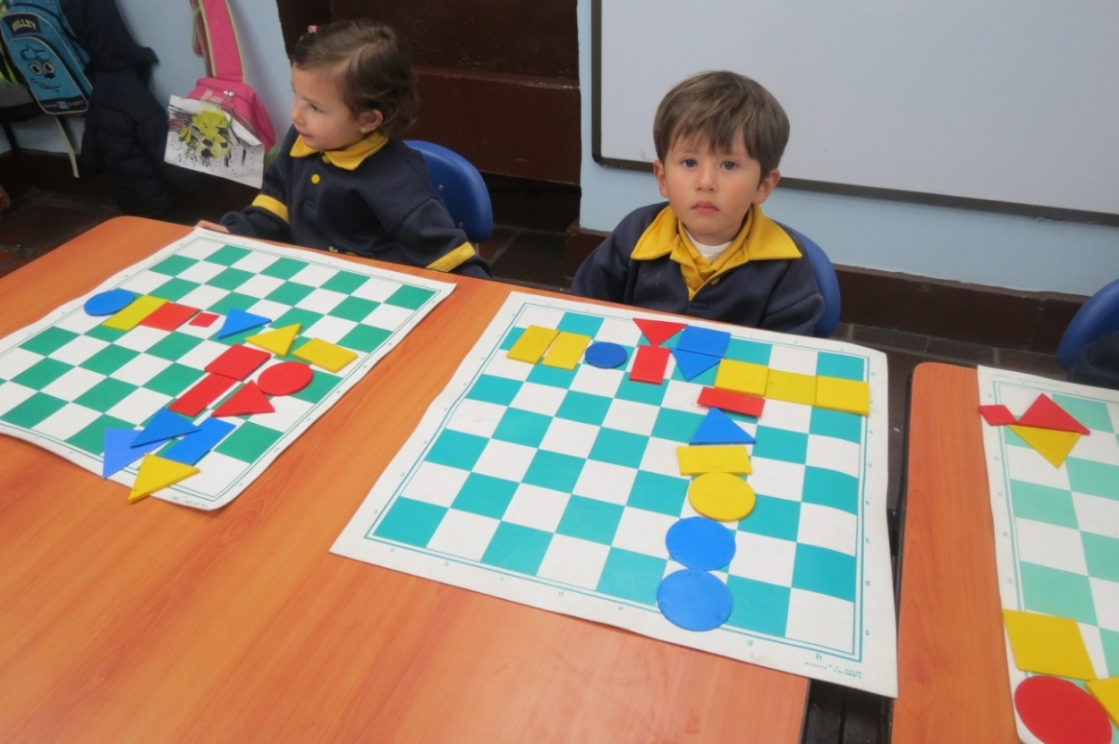
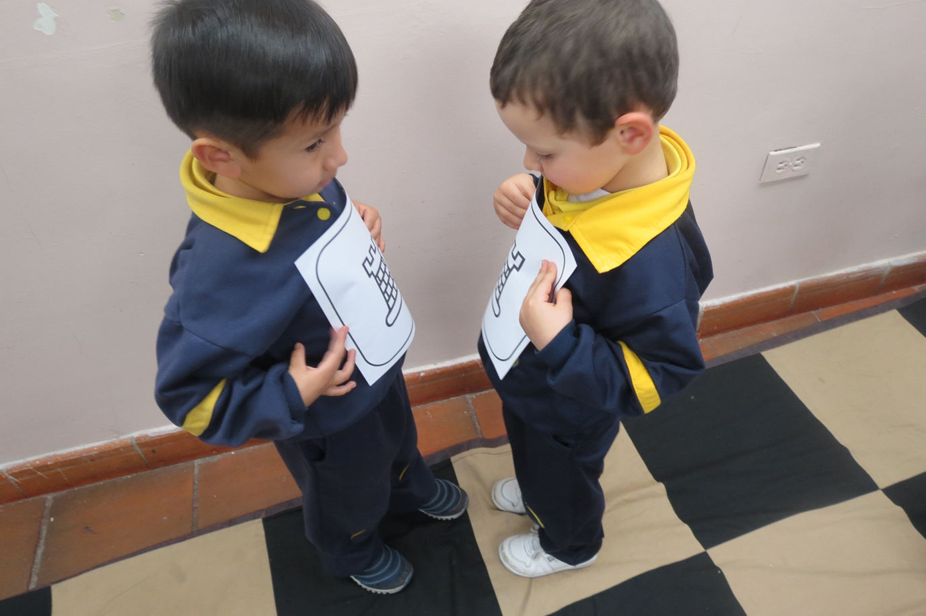

Slide 28
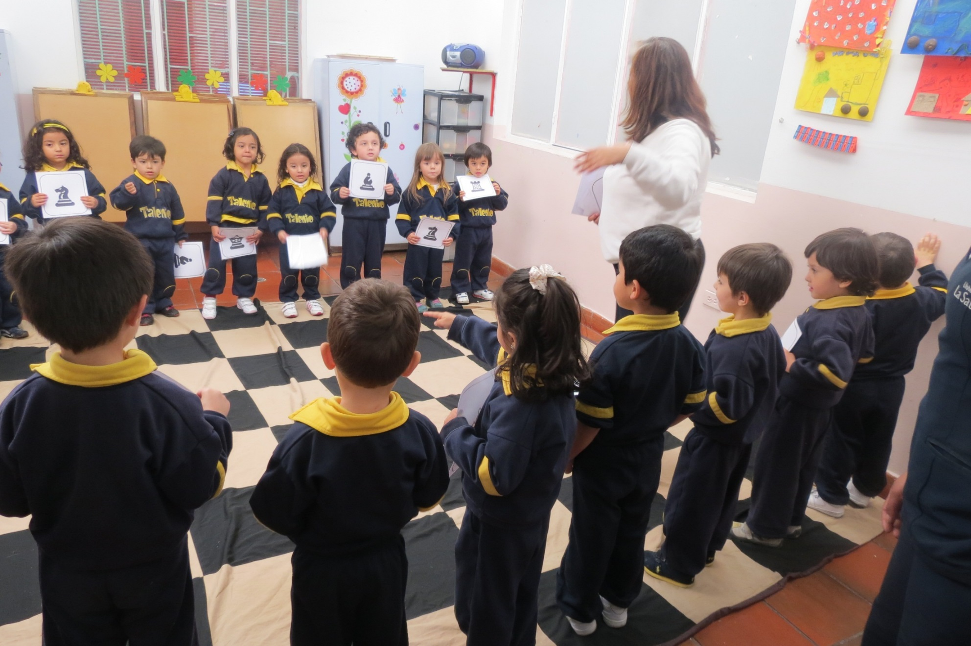

Slide 29
GARDNER´S EIGHT INTELLIGENCES
1. LINGUISTIC
2. LOGICAL-MATHEMATICAL
3. SPATIAL
4. INTRAPERSONAL
5. INTERPERSONAL
6. MUSICAL (CHESS)
7. BODILY-KINESTHETIC (CHESS)
8. NATURALISTIC?
CHESS

Slide 30
CHESS AND 21ST CENTURY:
INTERNET
-FLEXIBLE THINKING
-Permanent adaptation to a reality that changes every day
CRITICAL THINKING
-DECISION-MAKING

Slide 31
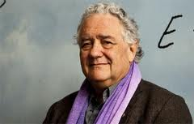
WAGENSBERG: CHESS TEACHES HOW TO LISTEN

Slide 32
OTHER SOCIAL USES
HYPERACTIV (ADHD)
AUTISM
ASPERGER SYNDROME
CHILDREN WITH CANCER
DOWN SYNDROM
BLIND/DEAF-MUTE/DISABLED

Slide 33
OTHER SOCIAL USES
UNEMPLOYED
INDIGENTS
SERIOUS MENTAL ILLNESS
PRISONS
REFORMATORIES (remand homes)
DRUG ADDICTS REHABILITATION

Slide 34
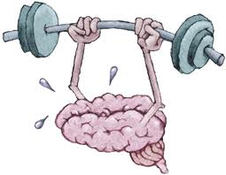
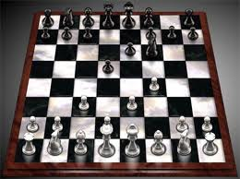
CHESS: THE BEST GYM FOR THE MIND

Slide 35
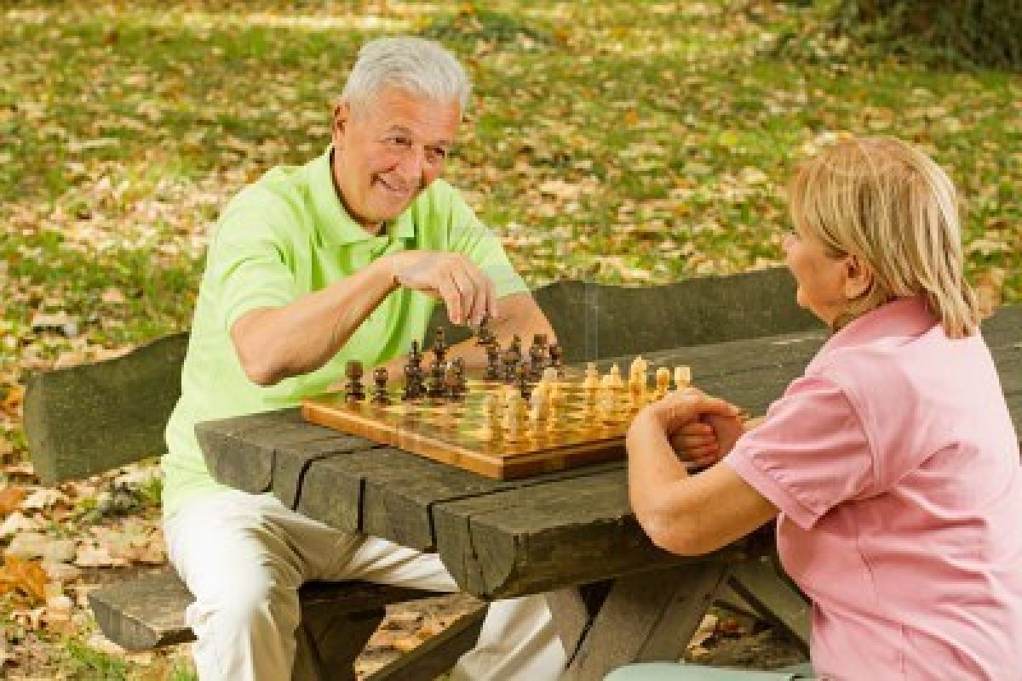
CHESS vs. ALZHEIMER
MEMORY
CONCENTRATION

Slide 36
CONCLUSSION:
The frequent practice of chess slows brain ageing, and can prevent or delay Alzheimer´s

Slide 37
Emma Pérez, director,
European School, Madrid
(chess in the curriculum since 1998):
“There is no other activity as powerful as chess in Preschool or Primary, because of the number of neuronal connections it produces”
“Internet teaches all the rivers and lakes of the World, but chess teaches how to think”.

Slide 38
HINDU PROVERB:
“ CHESS IS A SEA IN WHICH A GNAT MAY DRINK AND AN ELEPHANT MAY BATHE ”

Slide 39
leontxo@leontxo.com

